Slide 1
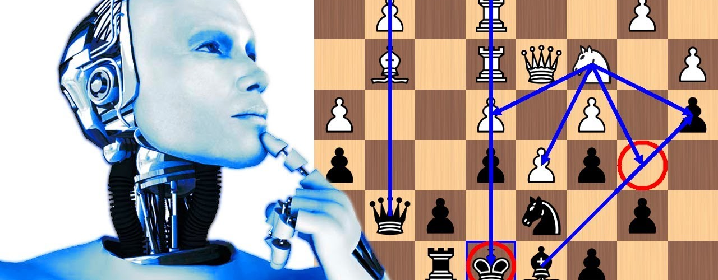

KINGSLAYER: AI Chess Engine
Using Deep Neural Network (DNN)

Slide 2
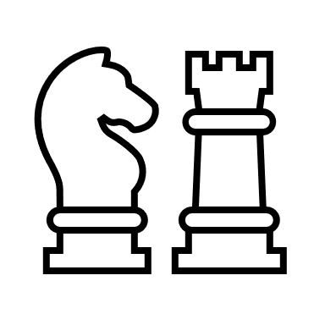


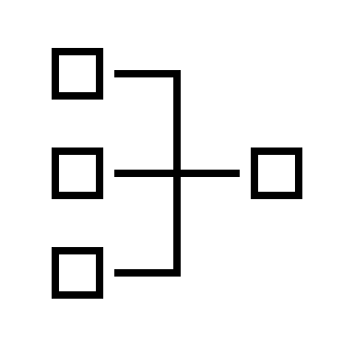
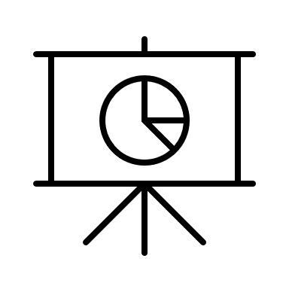

1
Project Flow
KINGSLAYER – AI Chess Engine
Developing AI Chess Engine
History of Chess –
to understand the game
Heuristics –
to evaluate and improve the game
Results –
comparison of our chess engine v. others
AI Inspired Games –
brief history of games developed using AI & ML
Deep Learning –
deploying deep neural network
Way Forward –
ways to improve the game in future
Project Objective
Develop an AI Inspired Chess Engine using Deep Neural Network

Slide 3
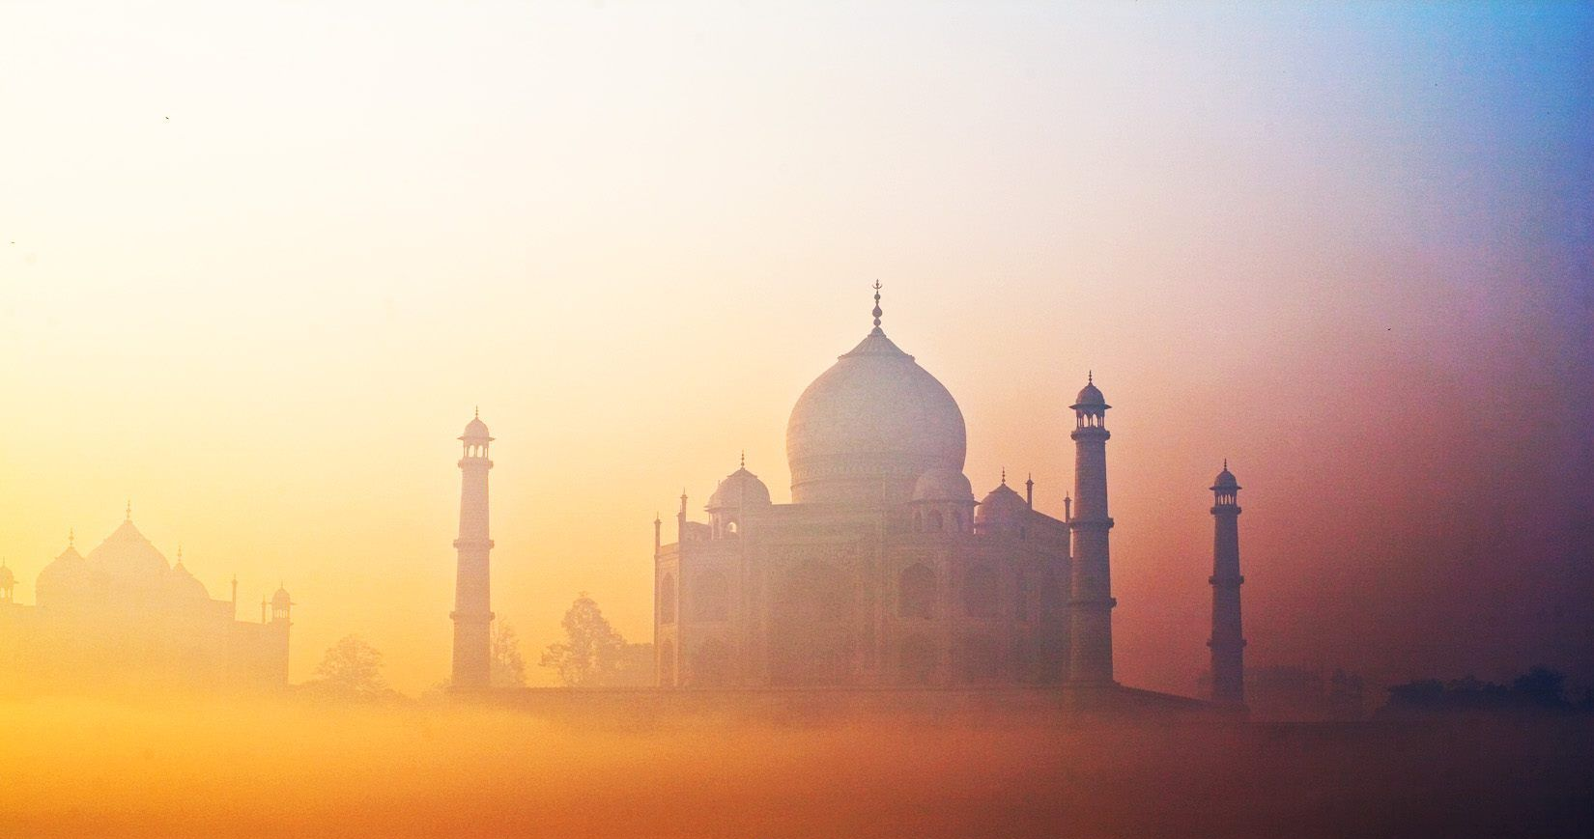
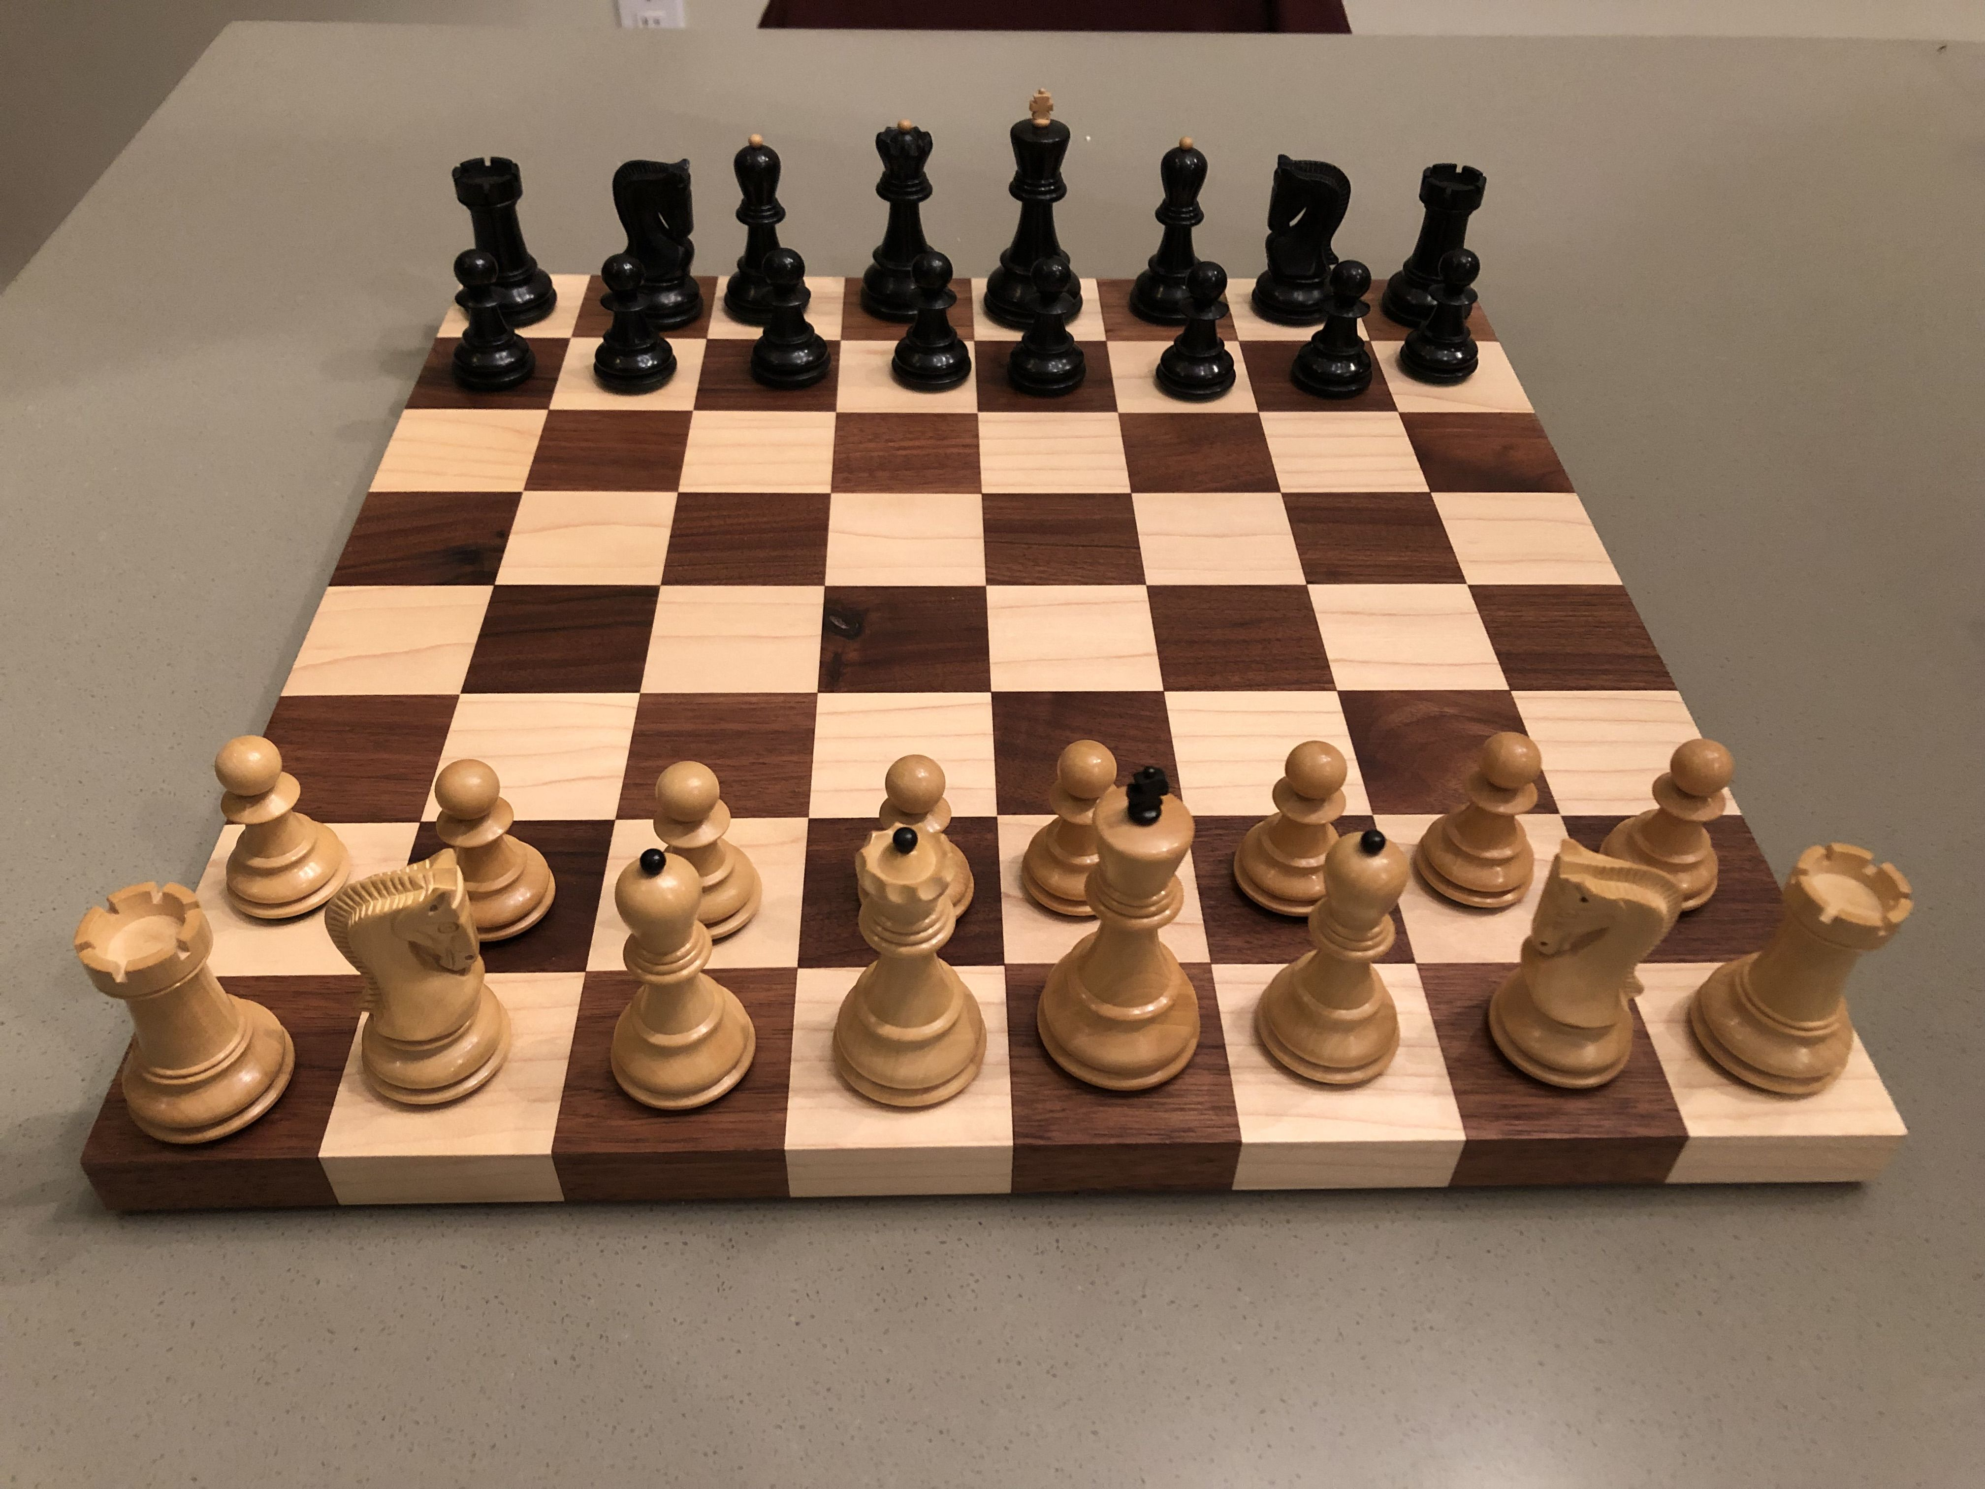
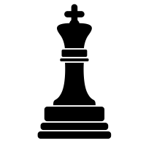
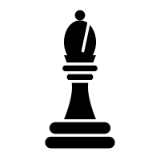



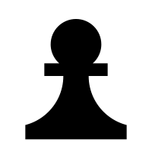

1
History of Chess
KINGSLAYER – AI Chess Engine
Brief History
Rules of the Game
Invented by an Indian philosopher in 6th Century
x1 King
x2 Bishops
x2 Rooks
Spread throughout the world by Persian Empire after 6th Century
x1 Queen
x2 Knights
x8 Pawns

Slide 4
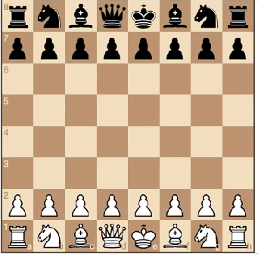
1
Chess Engine Demo
KINGSLAYER – AI Chess Engine
Functionalities Supported:
Pawn Capture
Castling
En Passant
Pawn Promotion

Slide 5
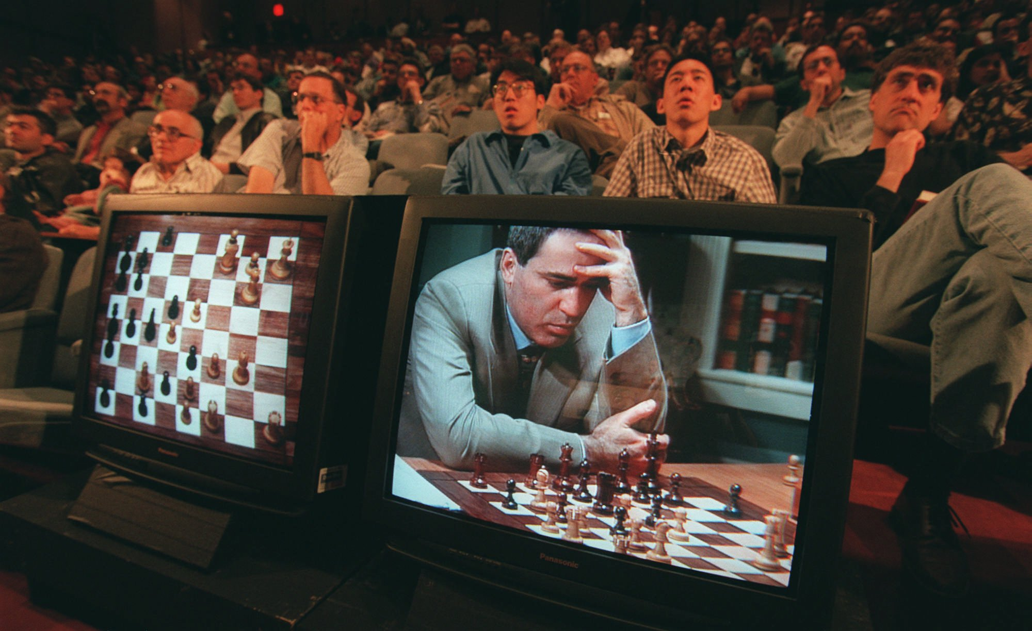
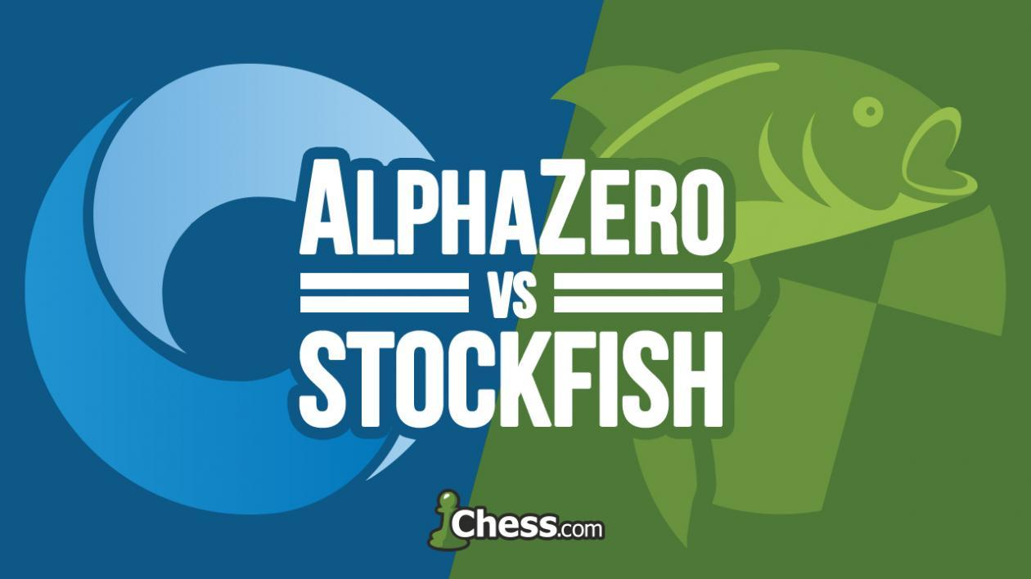
1
AI Inspired Computer Games
KINGSLAYER – AI Chess Engine
1997: IBM Deep Blue v. Kasparov
2017: AlphaZero v. Stockfish
2017: AlphaZero wins agaisnt Stockfish - 28 wins, 72 draws, 0 losses
AlphaZero was able to train on 19.6M games only in 4 hours
Blank state reinforcement learning, playing against itself
IBM Deep Blue beats Gary Kasparov
MiniMax / Alpha-Beta Pruning heuristics were used

Slide 6
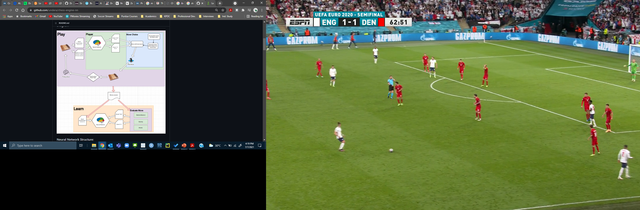

1
AI Inspired Computer Games
KINGSLAYER – AI Chess Engine
2020: Leela Chess v. Stockfish
Leela Chess Zero Beats Stockfish 106-94 in 13th Chess.com Computer Chess Championship
Leela Chess uses a trainable neural network to train its model

Slide 7
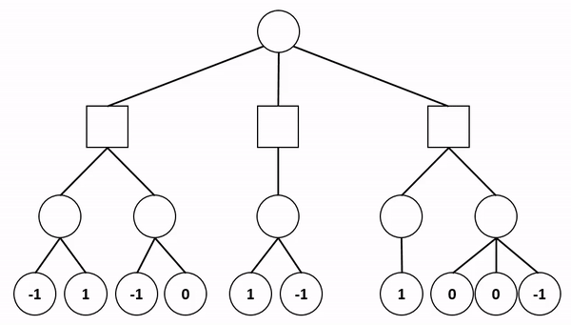
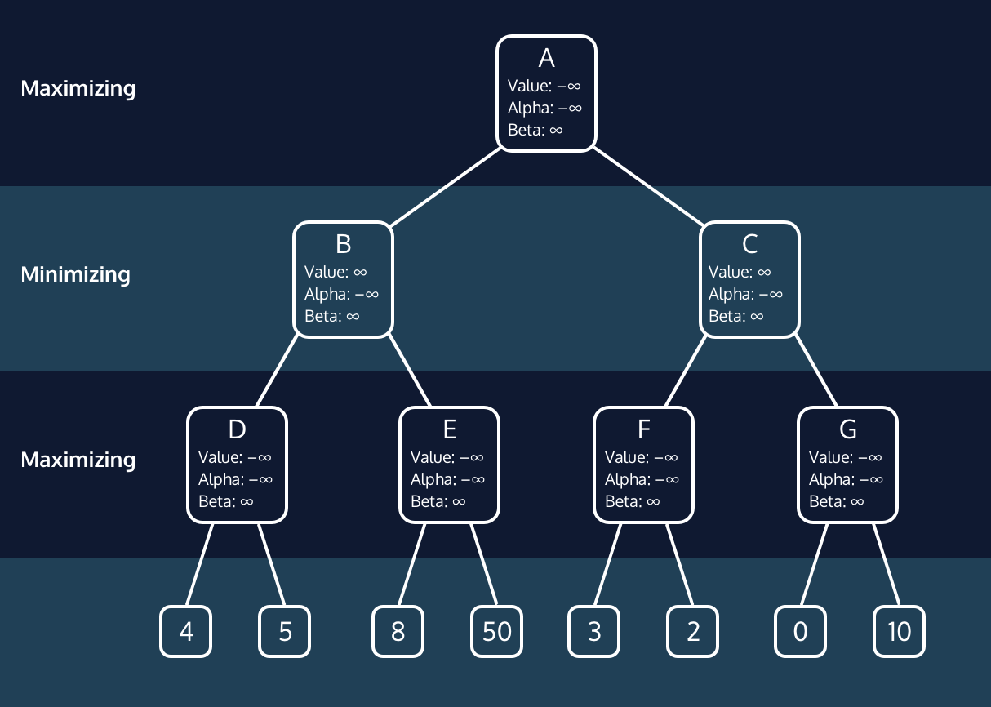
1
Determining Heuristics for Chess
KINGSLAYER – AI Chess Engine
Minimax Algorithm
Alpha Beta Pruning
Minimax algorithm takes advantage of the fact that chess is a zero-sum game meaning maximizing your chances of winning is the same as minimizing the opponent’s chances of winning.
Alpha-beta pruning makes brute-force search possible. It speeds up minimax by skipping the “irrelevant” nodes of a search tree.

Slide 8
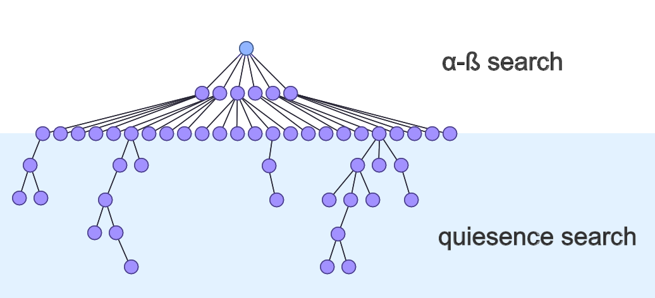
1
Determining Heuristics for Chess
KINGSLAYER – AI Chess Engine
Quiescence Search
Horizon Effect: Fixed length programs can easily miss multi-move sequences that take place towards the terminal nodes.
Example: If the AI only notices that it is down a piece without knowing that it can recapture on the next turn with a good position, then it is unlikely to play that move and will miss it.
Way Around: Perform a second limited search on the “unstable” terminal nodes through quiescence search, as it is meant to resolve a dynamic position into a stable one where the evaluation function will be more accurate.

Slide 9
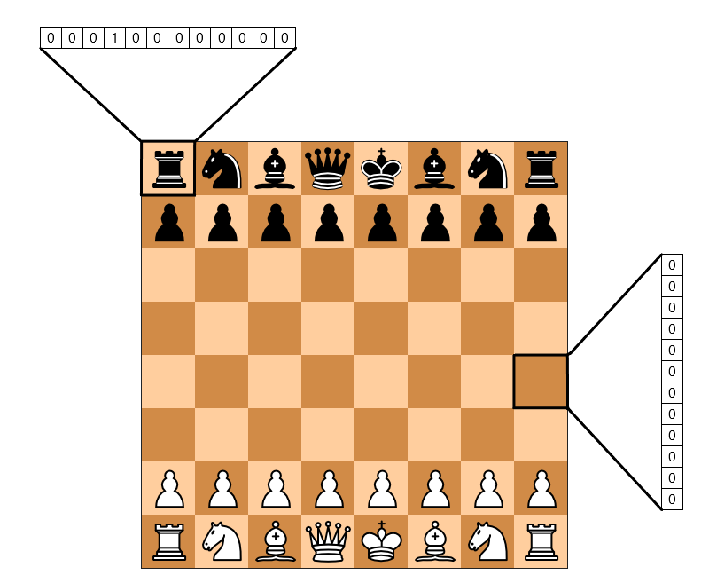
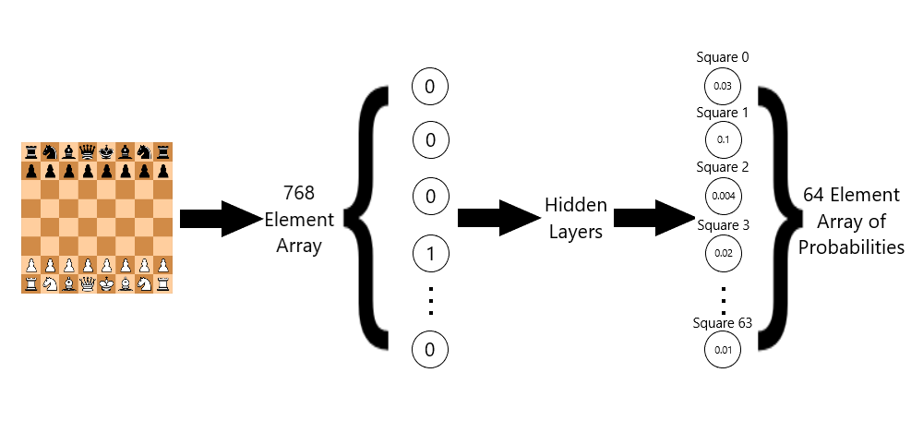
1
Deep Neural Network
KINGSLAYER – AI Chess Engine
Deploying Deep Neural Network (DNN)
3 hidden layers, neurons are activated using ReLU
Tanh function used for output layer to keep result between 1 & -1
Learning rate kept at 0.01

Slide 10
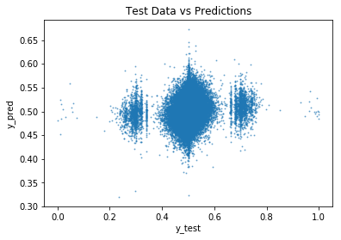
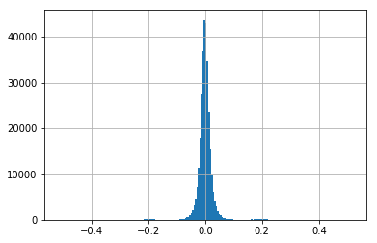
1
Evaluating Results
KINGSLAYER – AI Chess Engine
The RMSE squared is: 0.027312214481420634
The Mean Absolute Error is: 0.015326813953183204
The Median Absolute Error is: 0.009948693294039024

Slide 11
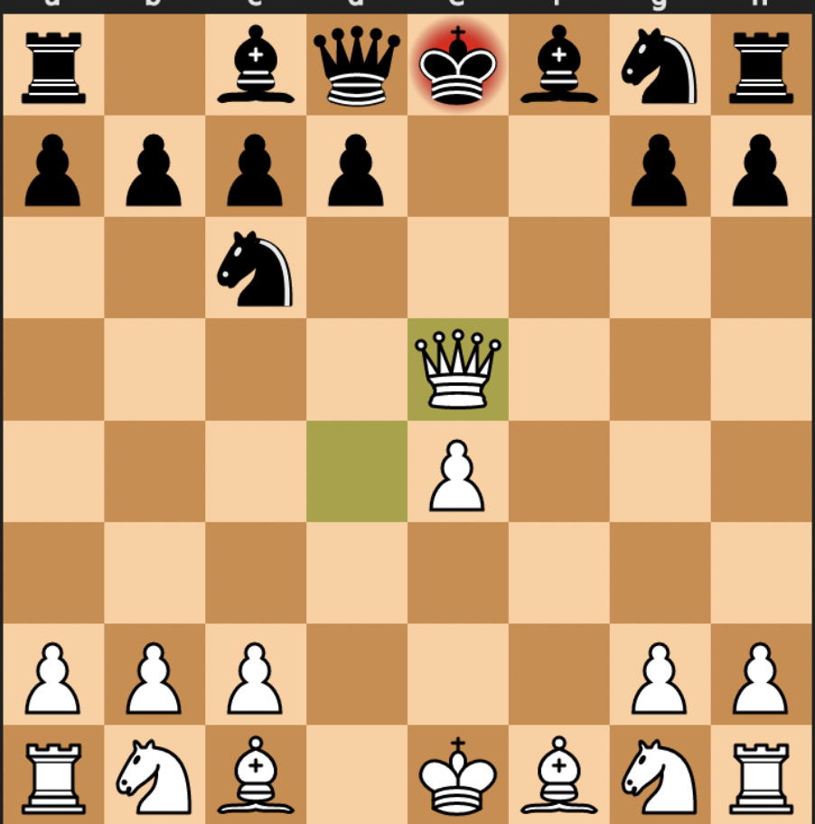
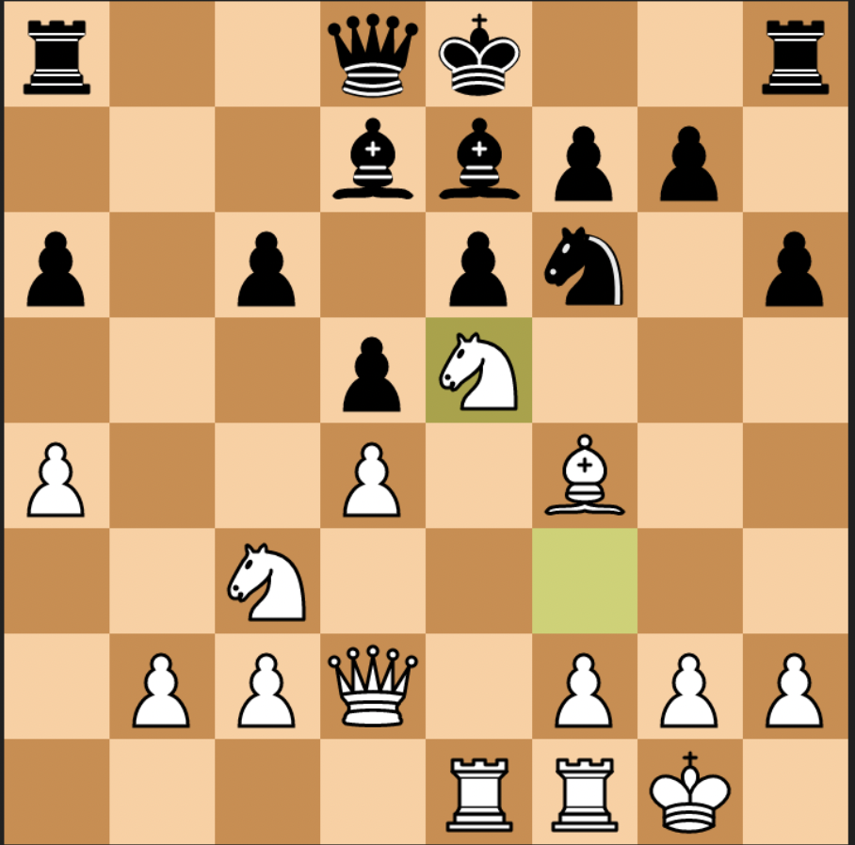
1
Evaluating Results
KINGSLAYER – AI Chess Engine
Board Evaluation Score = -.62
Board Evaluation Score = .68

Slide 12


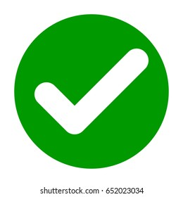





1
Evaluating Results vs. Bots
KINGSLAYER – AI Chess Engine
WIN
WIN
LOSE
WIN
DRAW
Based on these results we estimate the Elo rating of our chess engine to be somewhere around 1050 – 1150.

Slide 13
1
Way Forward
KINGSLAYER – AI Chess Engine
1
Improving the material evaluation by adding in the position of the material captured (capturing a pawn in the center of the board is more advantageous than capturing it when it is on the side).
2
Implementing other search heuristics like Monte Carlo Tree Search(MCTS)
3
Integrating our chess engine with Lichess engine API to get more accurate Elo rating.
4
We can keep an end game table similar to opening move table so that the chess engine can perform better during the end game.

Slide 14
Thank You!

